Slide 1
Full-Stack Web Development Lecture 7: Introduction to VueJS Ashley Williams Ashley.Williams@mmu.ac.uk

Slide 2
Learning Objectives
To understand:
Why we need front end frameworks
The basics of VueJS
Why we have chosen VueJS over other frameworks

Slide 3
Unit Overview
# | W/C | Lecture | Lab
1 | 03/10/2022 | Introduction to Full-Stack | Recap/RESTful APIs
2 | 10/10/2022 | Introduction to NodeJS/ExpressJS | Getting started with NodeJS/ExpressJS
3 | 17/10/2022 | Interacting with Databases | Interacting with Databases
4 | 24/10/2022 | Handling Authentication | Handling Authentication
5 | 31/10/2022 | Version Control | Assignment Support: Backend
6 | 07/11/2022 | API Security and Scaling | Assignment Support: Backend
7 | 14/11/2022 | Introduction to VueJS | VueJS Basics
8 | 21/11/2022 | Style, Layout, and Navigation | Layout and Navigation
9 | 28/11/2022 | Networking | Handling API requests
10 | 05/12/2022 | Structuring and Refactoring | Assignment Support: Front-end
11 | 12/12/2022 | Code Quality | Assignment Support: Front-end

Slide 4
Welcome to Front-End!

Slide 5
Recap
For the assignment, we are building two applications
Backend: Provides functionality to the rest of the world through an API
Frontend: Seen by the end users, uses the back end to provide functionality
The two are total separate applications, can sit on separate servers, at separate ends of the Earth – communicating over the internet
The client server architecture
SQLite DB
Backend API
Front-End

Slide 6
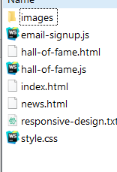
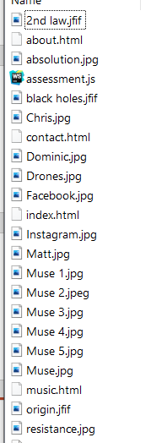
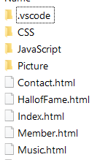
Last year’s web assessment…
I provided you with a backend application (hosted on mudfoot)
POST /mailinglist
GET /halloffame?year=2002
You created the front-end that interacted with those endpoints
The websites were written from scratch, meaning that you have full control over the structure of the code
"You can build a simple frontend with just three files: HTML, CSS, and JavaScript. However, as your app scales, your files will grow along with it, filling up with inscrutable and unmaintainable spaghetti code.“ - https://stackoverflow.blog/2020/02/03/is-it-time-for-a-front-end-framework/
This is fine for small projects, but we want to move towards being able to create massive, scalable solutions (fb, twitter, tinder)
Notes:
AQ – Right; RT – Bottom; WH - Top

Slide 7
Frameworks
For this, we can use existing frameworks to help us:
Proposed structures for scaling (we can still tailor to fit our needs)
Large amounts of functionality written for us (no need to write everything from scratch)
Maintained by massive communities of professional developers
What is a Framework?
Boilerplate code, covering functions that are reused by most applications
A directory structure, often following a design philosophy
A set of design principles your type of application frequently encounters
https://stackoverflow.blog/2020/02/03/is-it-time-for-a-front-end-framework/

Slide 8
Framework’s attempt to solve general problems:
Your code should be maintainable: easy for you and others to read, test, and change.
Complex interfaces are usually made of the same components. You should be able to create and reuse these components to easily create new pages.
Since DOM manipulations are slow, you want to perform as few element updates as possible.
You should be easily able to manipulate your UI based on data.
Your UI should be consistent and intuitive; this means standardizing typography, colour, buttons, inputs, and other elements.
You shouldn’t need to reinvent the wheel and write tons of boilerplate when it comes to solving these common front-end challenges.
You should have a common language through which to communicate your ideas and patterns with other developers.
https://stackoverflow.blog/2020/02/03/is-it-time-for-a-front-end-framework/

Slide 9
Types of Frameworks
There are many types of Frameworks:
Backend: ExpressJS is a web framework that we are now all familiar with
Frontend: VueJS, Angular (Google), React (Meta)
Style: Bootstrap, Tailwind

Slide 10
Advantages of Frameworks
Maintainability: Breaking up your app into reusable, standalone components makes it easier to make quick changes that don’t impact the rest of the application.
Separation of concerns: Modern framework design encourages a maintainable, modular architecture and allows front-end developers to focus on what they do best: taking data and displaying it to users in an intuitive and efficient way.
Speed: Boilerplate code aimed at addressing common problems makes it easier for you to get your app up and running; component-based design makes it quicker to develop.
Collaboration: Since frameworks often follow similar design patterns, it’s easier for developers who are new to your codebase to develop and maintain your app.
Community: Popular frameworks have a community of people around them with dedicated tutorials, forums, meetups, and generally supportive developers you can seek help from.

Slide 11
Disadvantages of Frameworks
Abstracted, overhead code: Until you’re thoroughly familiar with it, framework code is a black box. It can be hard to discern how much of the code is helpful to your application and frustrating to fix bugs resulting from code you’re not familiar with.
Learning curve: Learning to use a framework effectively takes time. To be productive, you need to understand the syntax, tooling, and philosophy behind how a framework functions. For projects where speed is essential, learning a brand new technology might not be the best use of your time.
Overkill for smaller projects: If you’re looking to deploy a static site or a site where every component is unique, you might not need the power and overhead of a full-fledged framework. It might still be helpful to implement a minimal framework or even library.

Slide 12
Disadvantages of Frameworks
Setup: Setting up and customizing a framework to your specific use case takes time. If speed is essential, go with what you know, or what your development team is comfortable with.
Strong opinions: An opinionated framework may feel constricting, and its design principles may clash with yours. Make sure you research the specific framework you’re implementing. If you prefer to build from scratch, go with your own solution.
Ecosystem evolution: The JavaScript framework ecosystem is famously volatile. The hottest framework of today may not be popular next year, and with this shift, developers and support may be hard to find.

Slide 13
VueJS

Slide 14
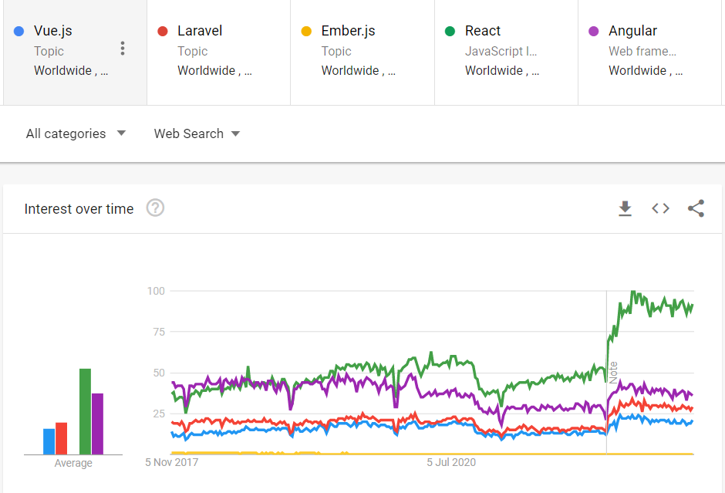
What is VueJS?
An approachable, performant and versatile framework for building web user interfaces.
Vue core - as of 1st Nov:
4,496 commits
33.5k stars
126 releases
344 contributors
Created by Evan You
Really cool documentary about VueJS (~34 mins): https://www.youtube.com/watch?v=OrxmtDw4pVI

Slide 15
Why VueJS?
There’s a “Why Vue” video on their homepage: https://vuejs.org/
But, my reasons for this unit:
It’s quick
It’s small
It’s lightweight
It’s really easy to learn
There are a tonne of resources online to help you

Slide 16
Component based Frameworks
App
Angular, React, and Vue are all component based frameworks
“A framework that encapsulates processing logic into modular components”
The app is essentially a hierarchy of components
Write a component once, and it can be used multiple times in your app
Once you know one component framework, others are relatively easy to pick up (i.e., learn Vue and React and Angular will be a lot more straight forward)
Router
Home Page
Login Page
Login Form
Text Box

Slide 17
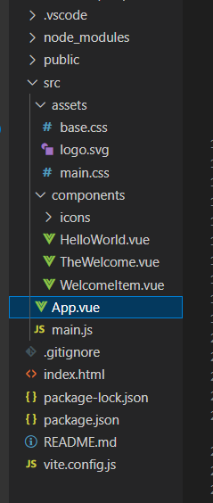
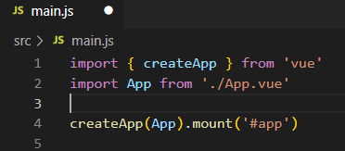
Creating a Vue app
“npm init vue@latest”
Answer the meta-data questions like with all Node projects
Delete the assets and pre-components
Index.html pulls in main.js, which initialises the App component (top of our hierarchy)
CSS and logo for welcome code
Welcome code
Index pulls in main.js which initialises App.vue
Index.html page
Package.json and README

Slide 18
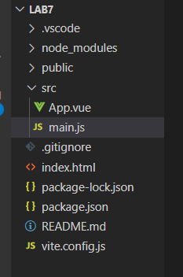
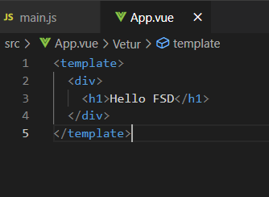
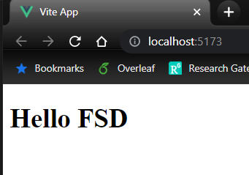
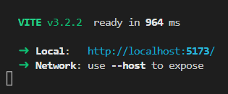
Running your app
Remove all welcome code
Edit App.vue
Run “npm run dev”

Slide 19
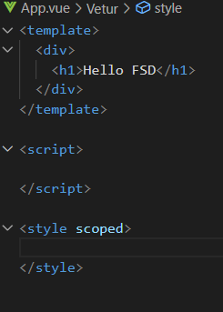
Vue Components
3 sections
Template – the HTML
Script – the JS
Style – the CSS

Slide 20
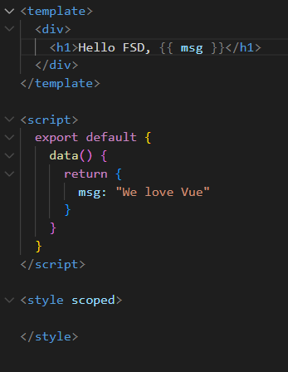
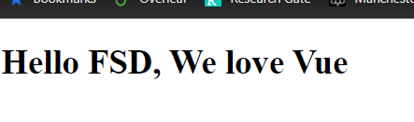
Vue Components: Script
Contains 3 core parts:
Data() – all of the data needed for the component (the variables)
Created() – a function that runs once the component has been created
Methods – a list of functions that can be called (e.g., when a button is clicked
Embed data into our template section with double curly brackets {{ like_this }}

Slide 21
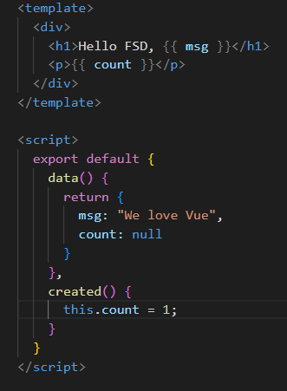
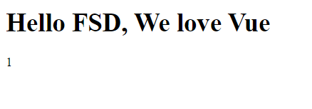
Vue Components: Script
Created() function runs once, when the component is first created

Slide 22
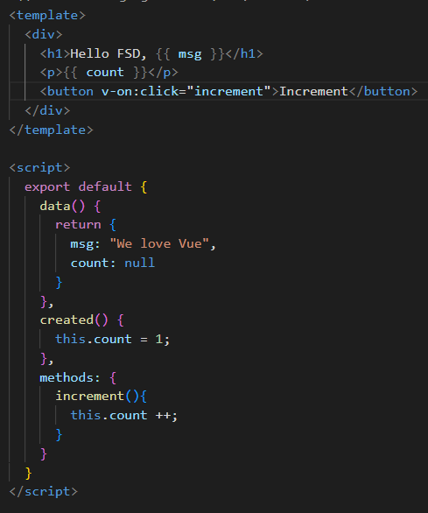
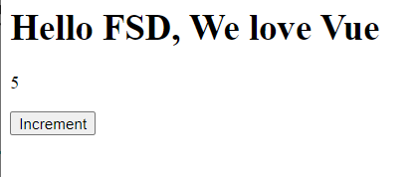
Vue Components: Script
Methods are a list of functions that the component has access to
Can be triggered on events (e.g., button clicks)

Slide 23
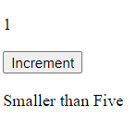
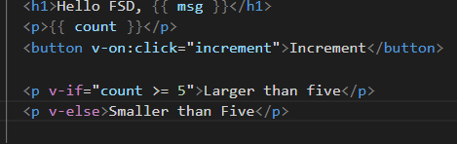
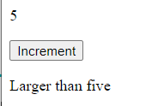
Vue Directives
Directives are instruction for VueJS to do things in a certain way.
There are lots, but the key ones are:
v-on:click – handles the click event of a clickable object (e.g., button, link)
v-if and v-else – allows us to conditionally render content on the screen
v-for – allows us to display content for each item in a list

Slide 24
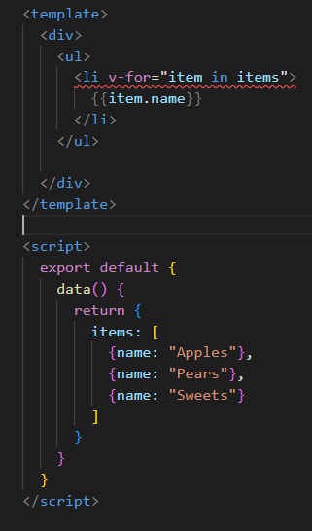
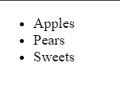
Vue Directives: v-for

Slide 25
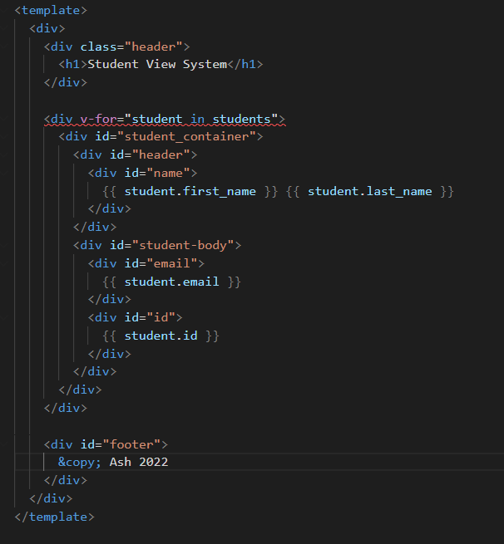
Vue Components
Components can quickly get large and messy

Slide 26
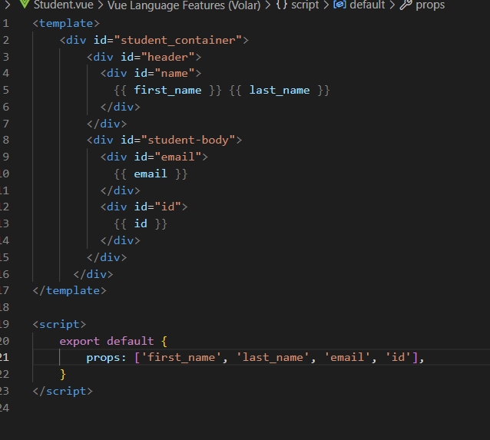
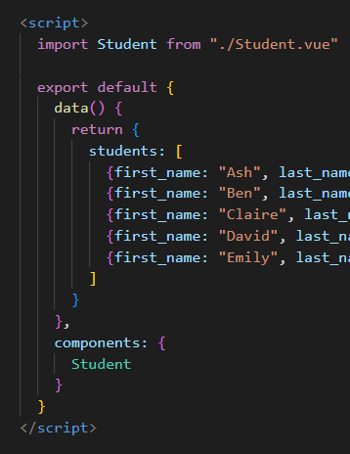
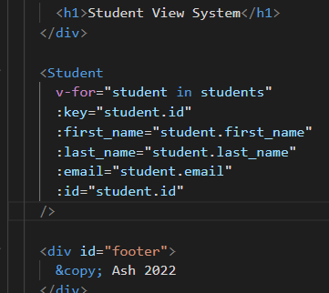
Vue Components
However, we can create more components to break them up
Create a new Student component
For each student, render an instance of the student component
Parameters passed to a component are called “props”

Slide 27
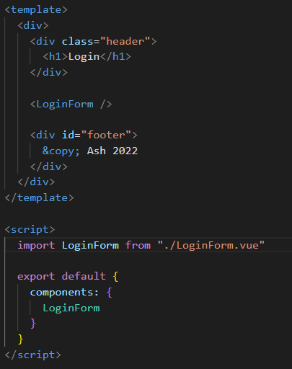
Example: Login Form
First we create a new component
Import it in so that we can use it

Slide 28
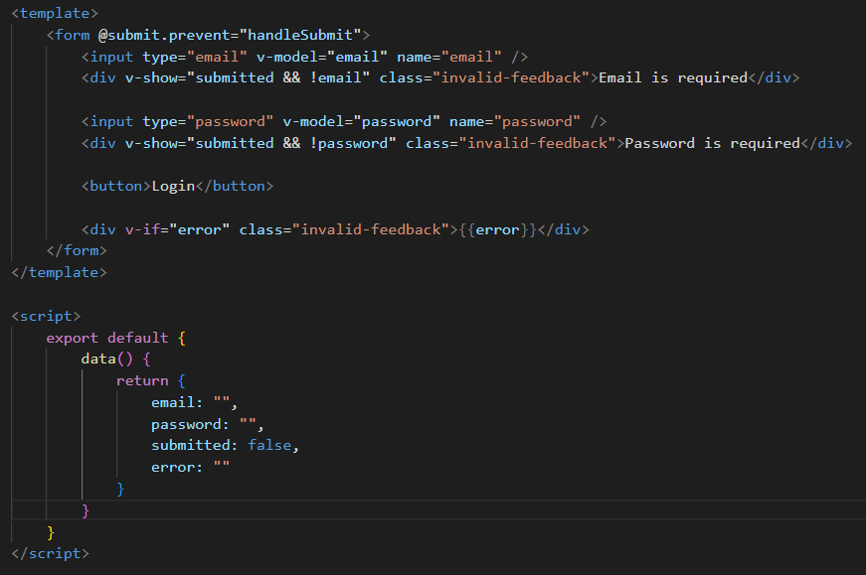
Example: Login Form
In the template, create the form
Create the data object in script
v-model: bind the input value to the data object
v-show: conditionally render content on the screen

Slide 29
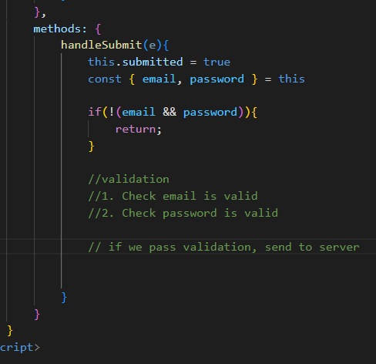
Example: Login Form
Add in the handleSubmit button
Validate incoming data (remember RegEx’s?)
If there is a problem with validation, update the error string
If we pass validation, then we can send to the server (next week)

Slide 30
Routing
So far, so good – but applications are made up of multiple components/pages/areas
For this we can implement a router
Allows users to navigate between different components
“npm install –save vue-router”

Slide 31
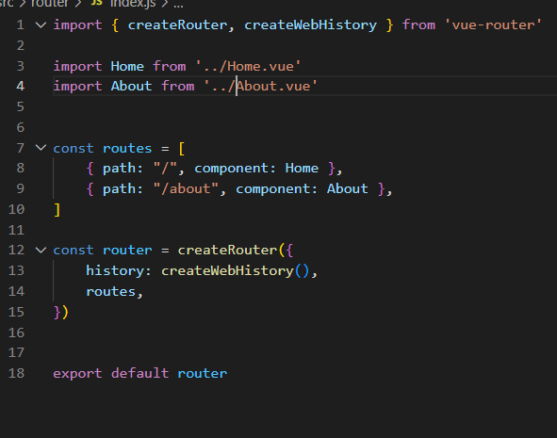
Routing: Create a file to store router information
Import the components
Create a list of route objects
Create the router, passing in the routes list
Export the router

Slide 32
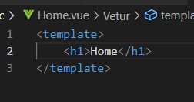
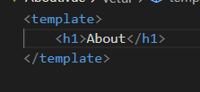
Routing: Create the components
Pretty empty for now, but that’s ok

Slide 33
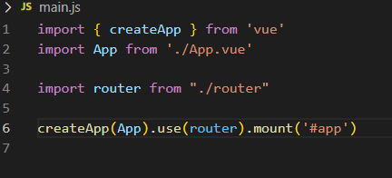
Routing: main.js
In your main.js:
Import the router you’ve created
Ensure that your app “uses” the router

Slide 34
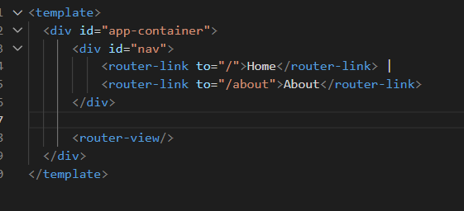
Routing: App.vue
In your App.vue file:
Use <router-view> to specify where the components will appear
Use <router-link> to navigate between different routes

Slide 35
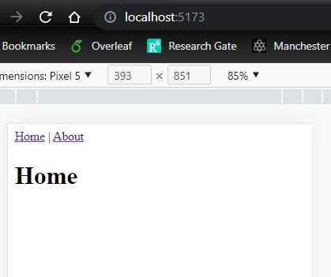
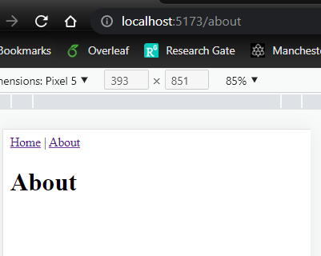
Routing: test
The route changes in the address bar, as well as the content on the page
We can now have multiple pages within our apps!

Slide 36
This week’s lab
In this week's lab, you will:
Learn how to create Vue apps
Practice creating components that can manipulate data
Create our first front-end application
Implement a router
Assignment Checklist:
Create an empty Vue project for your assignment
Create a router with the following pages:
/
/article/:id
/login
Sketch out a wireframe for your application on a piece of paper. Where will each of the API end-points be hit?

Slide 37
Questions?

